Slide 1


Advanced Debugging and monitoring your MVC Application with Log4net
MVC Rocks.NET
DevRock #01 Hello New Year 2015
Theeranit Pongtongmuang (Amm) VP of Engineering Noonswoon Co., Ltd

Slide 2
Agenda
MVC Rocks.NET
DevRock #01 Hello New Year 2015
What is log4net?
Why log4net?
Basic set up log4net
Log4net Configuration
Logger object
Appenders
Filter
Lossy log
Custom Appender with Azure Document DB
Tip log4php, log4j, log4javascript

Slide 3
Why do we need Logging?
MVC Rocks.NET
DevRock #01 Hello New Year 2015
Debugging application
Monitor app on production
Log to text file
Log to database
Log to SMTP to notify error
Easy and quick way to find error and fix the problem.
Help other developers to understand something wrong with your code.

Slide 4
What is log4net
MVC Rocks.NET
DevRock #01 Hello New Year 2015
Logging framework for monitor , debug your application
Port of log4j

Slide 5
Why’s log4net
MVC Rocks.NET
DevRock #01 Hello New Year 2015
Standard way of logging system
Can share knowledge to other platform Java , PHP
Portable configuration
A lot of appenders
Mature , many features and third party plugin

Slide 6
Basic Set up log4net
MVC Rocks.NET
DevRock #01 Hello New Year 2015
3 steps
Configure your log4net
Create logger object
Log something

Slide 7
DEMO
MVC Rocks.NET
DevRock #01 Hello New Year 2015
BasicConfiguration.csproj

Slide 8
Configuring Log4net
MVC Rocks.NET
DevRock #01 Hello New Year 2015
Default configuration
Simple, only for console
XML configuration
Flexible , can change on runtime, more appender
No compile time checked , lack of document of XML schema
Code
No data file to ship
Logging behavior is fixed, need to recompile

Slide 9
DEMO
MVC Rocks.NET
DevRock #01 Hello New Year 2015
ConfiguringLog4Net.csproj

Slide 10
External Config File
MVC Rocks.NET
DevRock #01 Hello New Year 2015
2 options
Attribute , ConfigFile or ConfigFileExtension choose only one
AppSetting (log4net.Config, log4net.Config.Watch key)
This file path is relative to the application base directory (AppDomain.CurrentDomain.BaseDirectory).
Set file Copy to output directory: Copy Always

Slide 11
External Config File
MVC Rocks.NET
DevRock #01 Hello New Year 2015
[assembly: log4net.Config.XmlConfigurator(ConfigFile = "log4net.xml", Watch = true)]
[assembly: log4net.Config.XmlConfigurator(ConfigFileExtension = "log4net", Watch = true)]
<add key="log4net.Config" value="log4net.xml"/> <add key="log4net.Config.Watch" value="true"/>

Slide 12
DEMO
MVC Rocks.NET
DevRock #01 Hello New Year 2015
ExternalConfigFile.csproj

Slide 13
DEBUG log4net configuration
MVC Rocks.NET
DevRock #01 Hello New Year 2015
Forget to initialize Log4Net
BasicConfigurator.Configure();
XmlConfigurator.Configure();
[assembly: XmlConfigurator]
Log level not set to OFF
Looking for debugger windows during debug session
Set layout to appender (not show error but empty screen)
Applied appender to logger (not show error)
Turn on log4net internal debugging
Log the first message after initialization

Slide 14
DEMO
MVC Rocks.NET
DevRock #01 Hello New Year 2015
InternalDebugging.csproj

Slide 15
Level
Level | Use Case | Usage
DEBUG | For development purpose
INFO | General business information
WARN | Warnings about unexpected events
ERROR | Serious problems in your application
FATAL | Super Serious problem, can break application
MOST
LEAST

Slide 16
DEMO
MVC Rocks.NET
DevRock #01 Hello New Year 2015
Log4NetLevel.csproj

Slide 17
Appender
MVC Rocks.NET
DevRock #01 Hello New Year 2015
Logging Event destination, place that logging event will be process, to be write to
There are some shared property for each appender
Threshold - level for appender
BufferSize , default to 512 message to buffer

Slide 18
SOME Appenders
MVC Rocks.NET
DevRock #01 Hello New Year 2015
ConsoleAppender, ColoredAppender
FileAppender , not use for production
RolloingFileAppender
By size
By amount of time

Slide 19
Rolling File Appender
MVC Rocks.NET
DevRock #01 Hello New Year 2015
RollingStyle
Once, Date, Size, Composite
MaxFileSize
Default to 10 MB
MaxSizeRollBackups
0 no backup only single log file
-1 no deletions ,keep all
CountDirection
>=0 new log files have higher index numbers
<0 new log files have lower index number (default)

Slide 20
DEMO
MVC Rocks.NET
DevRock #01 Hello New Year 2015
ColoredAppender.csproj

Slide 21
DEMO
MVC Rocks.NET
DevRock #01 Hello New Year 2015
FileAppender.csproj

Slide 22
Rolling File Appender
MVC Rocks.NET
DevRock #01 Hello New Year 2015
DatePattern
DateTimeStrategy
StaticLogFileName
PreserveLogFilenameExtension
PreserveLogFilenmaeExtension = true & countDirection = 1 & StaticLogFilename = false, Not delete data

Slide 23
DEMO
MVC Rocks.NET
DevRock #01 Hello New Year 2015
RollingFileAppender.csproj

Slide 24
ADO.NET Appender
MVC Rocks.NET
DevRock #01 Hello New Year 2015
Any database that ado.net support
ConnectionString
ConnectionStringName
ConnectionType , ADO.NET type
ReconnectionOnError retry when error
CommandType, Text or StoredProcedure
CommandText , SQL or StoredProcedure Name
UserTransactions
Parameters

Slide 25
ADO.NET Appender
MVC Rocks.NET
DevRock #01 Hello New Year 2015
Parameter Property
DBType
Size
Precision
Scale
Layout
Install-Package System.Data.SQLite.Core

Slide 26
DEMO
MVC Rocks.NET
DevRock #01 Hello New Year 2015
AdoNetAppender.csproj

Slide 27
SMTP Appender
MVC Rocks.NET
DevRock #01 Hello New Year 2015
SMTP
Username
Password
Authentication
Port
From
To
Subject
Buffersize

Slide 28
DEMO
MVC Rocks.NET
DevRock #01 Hello New Year 2015
SmtpAppender.csproj

Slide 29
Pattern Layout
MVC Rocks.NET
DevRock #01 Hello New Year 2015
Simple Layout
Xml Layout
Pattern Layout
[%logger] %-5level - %message %newline

Slide 30
Pattern Specification
MVC Rocks.NET
DevRock #01 Hello New Year 2015
"%date %thread - [%5level] %10.30logger %message%newline%exception”
%
Variable
Modifiers
Right justify , move to right, add space left [ INFO]
- Left justify, move to left, add space on right [INFO ]

Slide 31
Pattern Specification
MVC Rocks.NET
DevRock #01 Hello New Year 2015
Recommend
Date
Exception
level
Logger
Message
Thread
High cost not good for production
Identity, username,file, location,line,method,stacktrace

Slide 32
DEMO
MVC Rocks.NET
DevRock #01 Hello New Year 2015
LayoutAndPattern.csproj

Slide 33
Logger object
MVC Rocks.NET
DevRock #01 Hello New Year 2015
Use for log thing, interfacing with log4net
Isolated application logging
Multiple logger object in application
Each log can have difference level & appender

Slide 34
DEMO
MVC Rocks.NET
DevRock #01 Hello New Year 2015
LoggerObject.csproj

Slide 35
Filter
MVC Rocks.NET
DevRock #01 Hello New Year 2015
Type of Filter
acceptOnMatch
True > Log
False > Deny
neutral > next to filter (not exist for LevelRangeFilter)

Slide 36
DEMO
MVC Rocks.NET
DevRock #01 Hello New Year 2015
Filter.csproj

Slide 37
Lossy Logging
MVC Rocks.NET
DevRock #01 Hello New Year 2015
Logging only importance context
Try to get more info with less resource

Slide 38
DEMO
MVC Rocks.NET
DevRock #01 Hello New Year 2015
LossyLog.csproj

Slide 39
Log4net for Mvc Application
MVC Rocks.NET
DevRock #01 Hello New Year 2015
Config in web.config
Initialize in Global.ascx

Slide 40
DEMO
MVC Rocks.NET
DevRock #01 Hello New Year 2015
MvcLog4Net.csproj

Slide 41
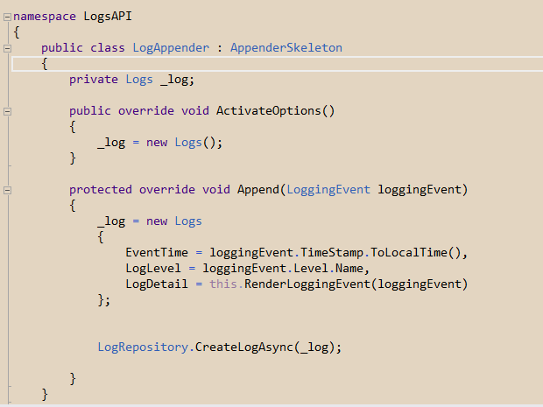
Extend Log4NET, Azure document db
MVC Rocks.NET
DevRock #01 Hello New Year 2015

Slide 42
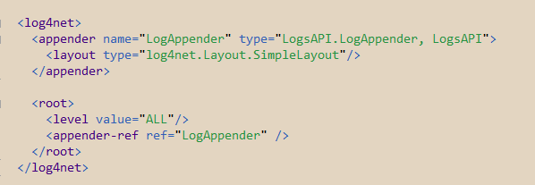
Extend Log4NET, Azure document db
MVC Rocks.NET
DevRock #01 Hello New Year 2015

Slide 43
TiPS Log4J Log4PHP Log4JavaScript
MVC Rocks.NET
DevRock #01 Hello New Year 2015

Slide 44
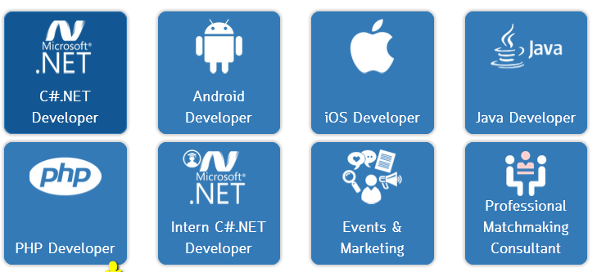
Noonswoon Careers
MVC Rocks.NET
DevRock #01 Hello New Year 2015
noonswoonapp.com/careers

Slide 45
Thank you
MVC Rocks.NET
DevRock #01 Hello New Year 2015

